Slide 1
Circuit design in eagle
Krister Borge
Elektronics & computertechnology, employed at Sonen.
http://sonen.ifi.uio.no
http://fauxclef.wordpress.com
Notes:
Hi.
Norwegian or English?
Introduce myself: I am Krister Borge, Study electronics and computer Science at institute for physics. And I work at sonen.
I have as long as I know been interested in technology and how stuff works. Probably everyone else as well.
I have some experience with arduino as development board and have built different projects with it.
In this course we will try to learn more about what an arduino actually is, and what we can do to make our own little AVR- Programmer [Next SLide]

Slide 2
eagle free
CADsoft Eagle Light Edition is free
CAD-tool for electronics
A deverse and rich library of parts and footprints
Layout and schematic
Limitations for the free tool
Size of layout (Board) 100 x 80 mm
The useable board area is limited to 100 x 80 mm (4 x 3.2 inches).
Only Top and Bottom signal layers can be used.
The schematic editor can only create one sheet.
Non-profit ☺

Slide 3
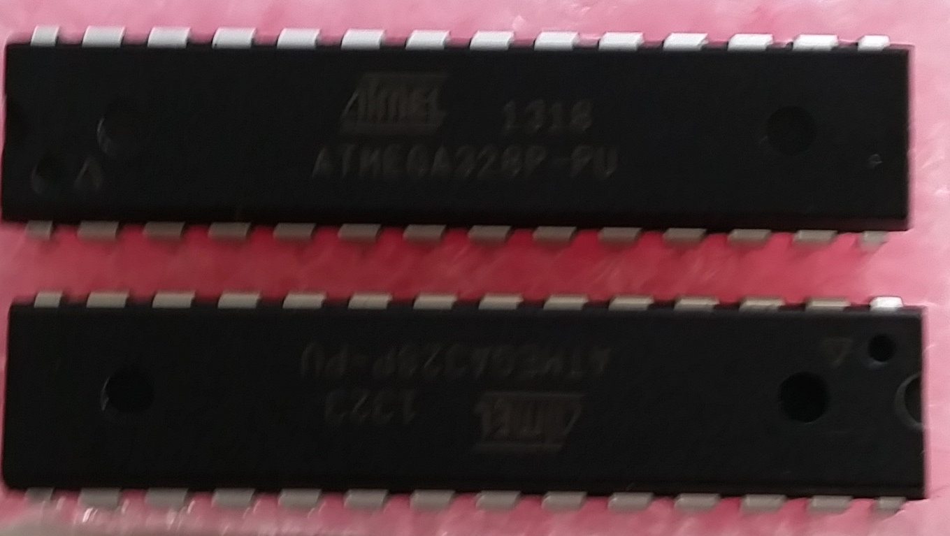
Let the fun begin
ATMEGA328P-PU – a microcontroller, it is used (among others) in the Arduino UNO
Naming
AT =Atmel
MEGA series
328P chip specification- 32kb flash memory 2k sRAM,8P is 28pin dip package
PU means that it is pinned (DIP)
AU means surface mounted (TQFP)
Eagle library for this part can be found here: http://www.ladyada.net/wiki/partfinder/microcontroller
Notes:
AVR as an mcu. AVR was developed by two norwegians, Wikipedia: Atmel AVR er en familie mikrokontrollere fra Atmel.
AVR-arkitekturen har utgangspunkt i to diplomoppgaver fra NTH skrevet av Vegard Wollan og Alf-Egil Bogen. Sammen med Gaute Myklebust patenterte de arkitekturen og Atmel Norway ble grunnlagt i 1996 som design-senter for AVR-mikrokontrollere.
AVR er basert på en 8-bits arkitektur optimalisert for effektiv kompilering av kode skrevet i C.
The AVR is realtively simple in structure but it is extremely versatile aswell as fast and efficient compiling of C-code.
In this talk I will use the ATMEGA328/168p –PU
Og fast through the naming convention by atmel

Slide 4
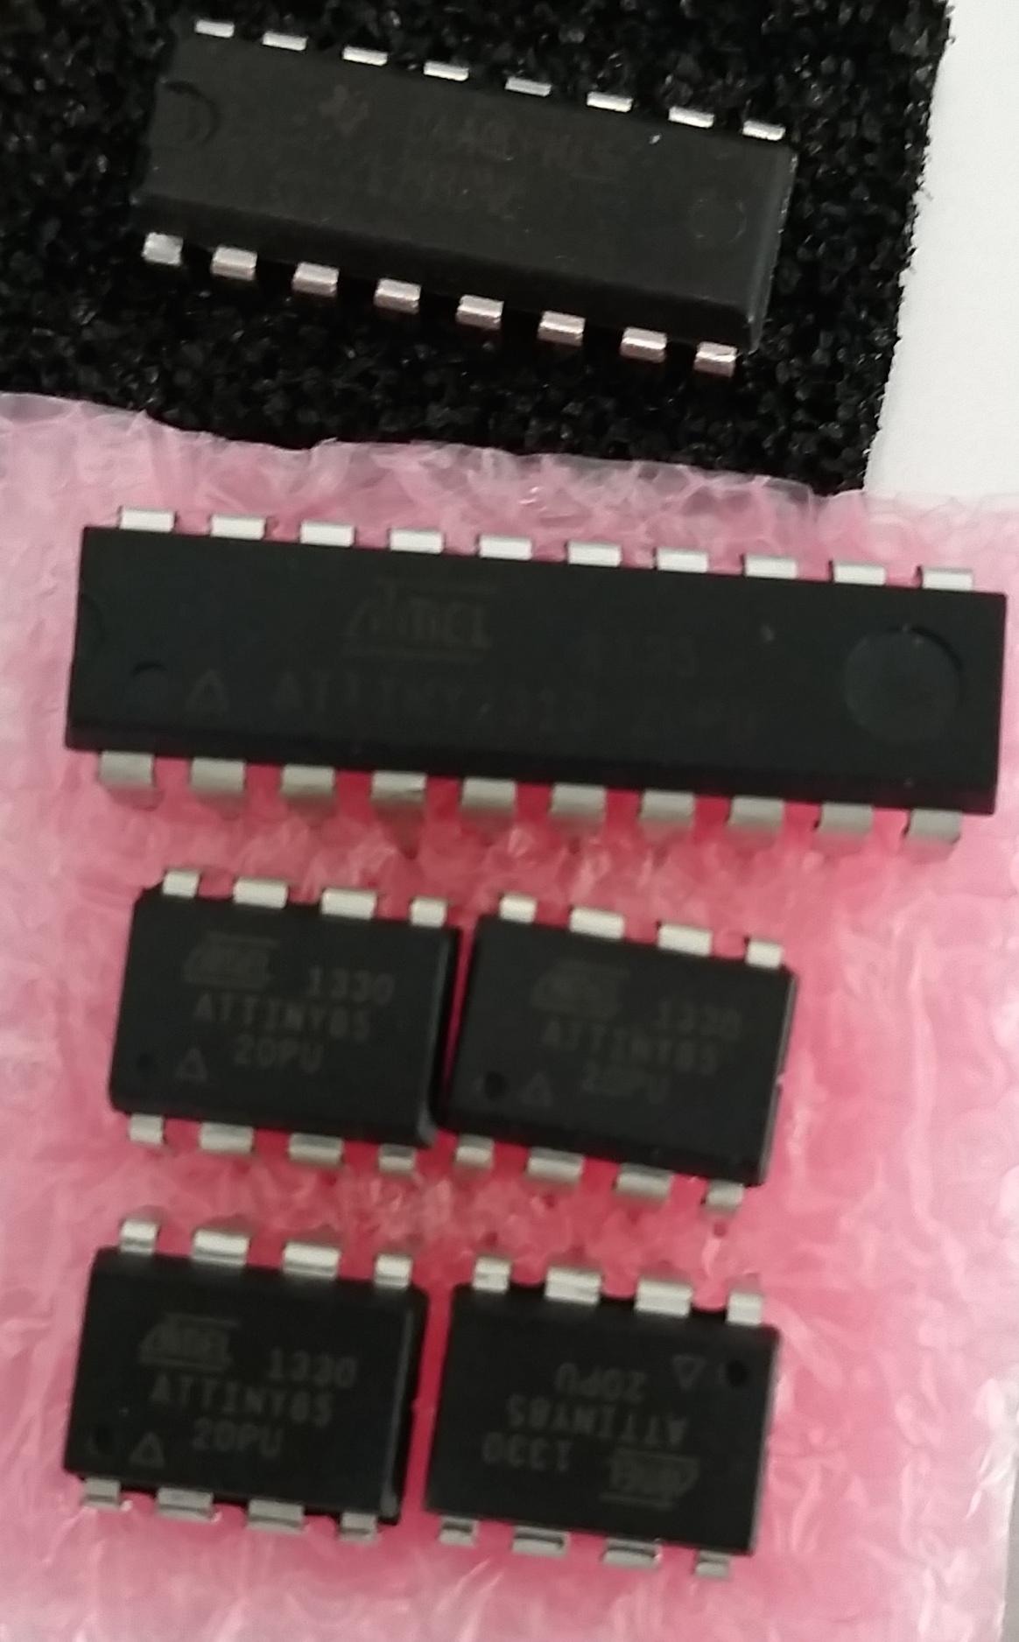
ATTINY

Slide 5
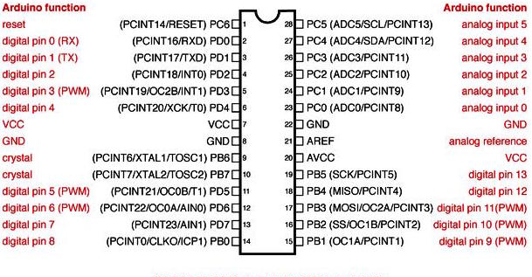
Datasheet for the ATMEGA328p-pu
Notes:
Pin mapping for out DIP. Explain some of the pin names and what the can do.
XTAL - Crystal
AIN – Analog Converter positive and negative input
TOSC - Oscillator
PCINT external interupt source
OC1A/OC1B -Counter1 Output Compare Match A/B Output
MISO – Serial converter in
MOSI – Serial converter out
AVCC – Analog VCC
SCK – SPI bus master Clock
ADC - Analog to digital converters
ICP – input capture pin
SDA - Two wire data
SCL - Two wire clock
SS – Slave Select

Slide 6
Bare-bone avr programmer-BOM
Bill of Materials:
16mHz crystal
Leds
22pF ceramic capacitors
10uF capacitor
220 ohm resistor
10k ohm resistor
Atmel atmega328p-pu
pinheaders
16mHz crystal
Momentary switch
9v battery connector (barrel)
9v battery
Voltage regulator 5V and 3.3 V (TO-220)
barrel connector
Notes:
Parts we will need in Eagle. And libraries fra sparkfun and adafruit,

Slide 7
Adding libraries
Libraries contain schematic symbols and footprints of parts.
Smd, connectors, headers, jumpers, passives, ICs, ++
It can some times be critical to choose the right part, but must of the times a footprint tha resembles what we want is enough.
It is possible to create yout own schematic symbols with attached footprint,

Slide 8
Lets place some parts
Open Eagle and follow my lead.
Notes:
Åpne Eagle. Legg til deler og sett verdiene på resistorene og caps, begynn med power delen

Slide 9
Net, bus or wire
Net builds the rastnet for the board -> links the different parts.

Slide 10
ERC
Elictrical Rules check
Checks the schematic for faults and gives errors and warnings.

Slide 11
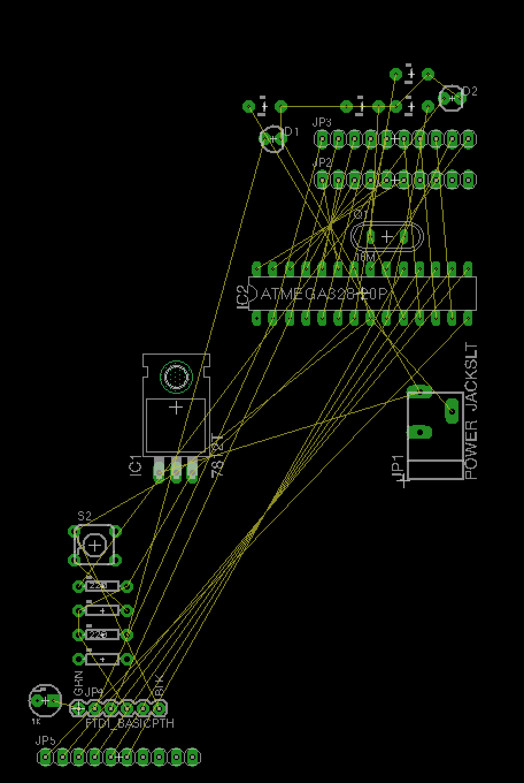
RASTnest
The Rast nest is a graphical representation of where the routes og befor routing is done.
We will now start routing.
Notes:
Husk at alt er speilvendt

Slide 12
Why mirror

Slide 13
Autorouter
The autorouter is creating routing automatically.
We can create rules for the autorouter
Often we get a better result with manual routing.

Slide 14
DRC
Design Rules Check
We have a 1/32” square endmill on our machine
That means that the minimum distance between leads and footprints is 1/32”
Eagle units is mil
1/32” =31.25 mil
In drc holes and distance must be over this.
32 mil is a nice number

Slide 15
Copperblanks and the othermill
To get this right every part must be mirrored.
To get the parts soldered and correctly placed.
We can create new footprints
We can rotate the part in place and place the parts rightin assembly.

